Slide 1
Spring BOOT
BY DHRUV DHOLARIYA

Slide 2
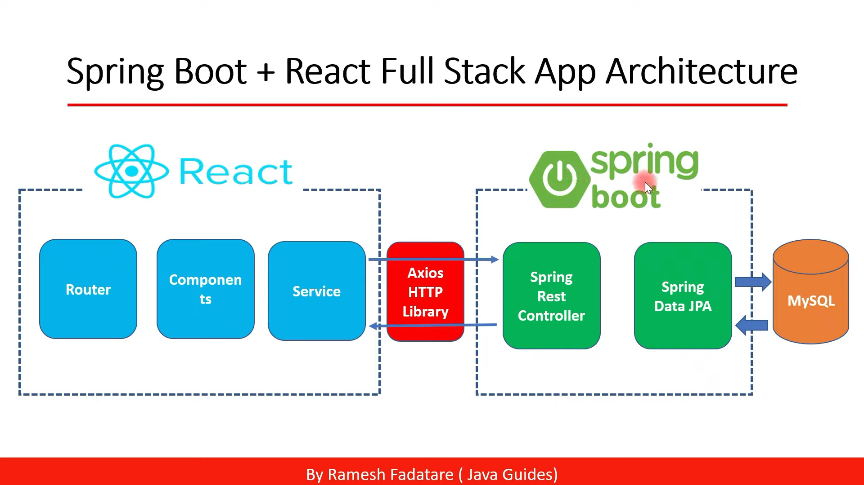

Slide 3
Extra
What is servlet ➔

Slide 4
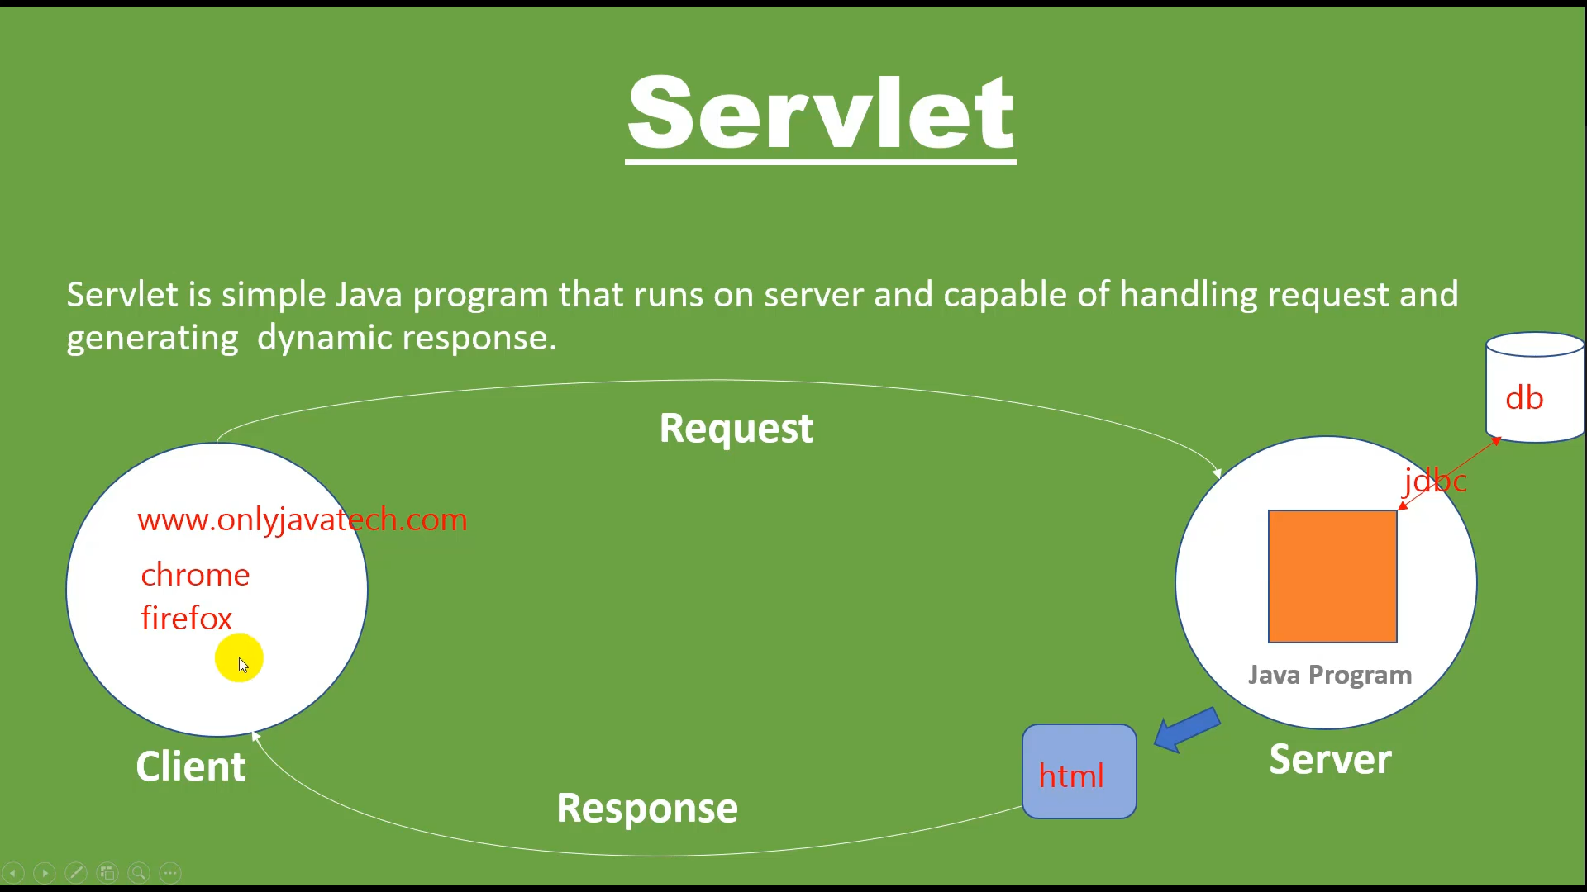
servlet

Slide 5
Extra
What is Apache tomcat ? ➔

Slide 6
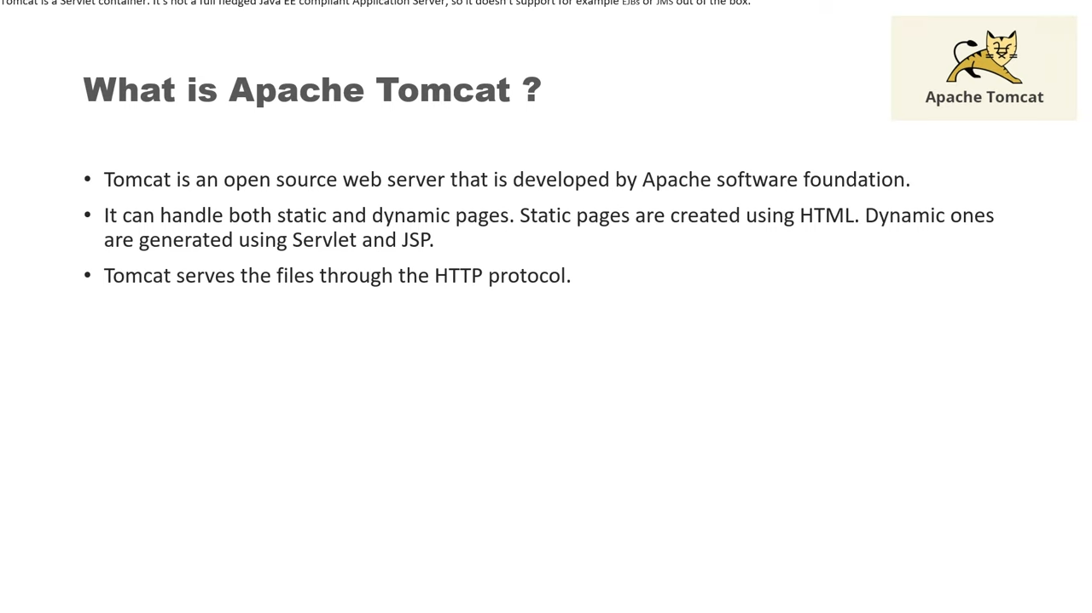

Slide 7
Extra
What is jsp(Java Server Pages) ? ➔

Slide 8
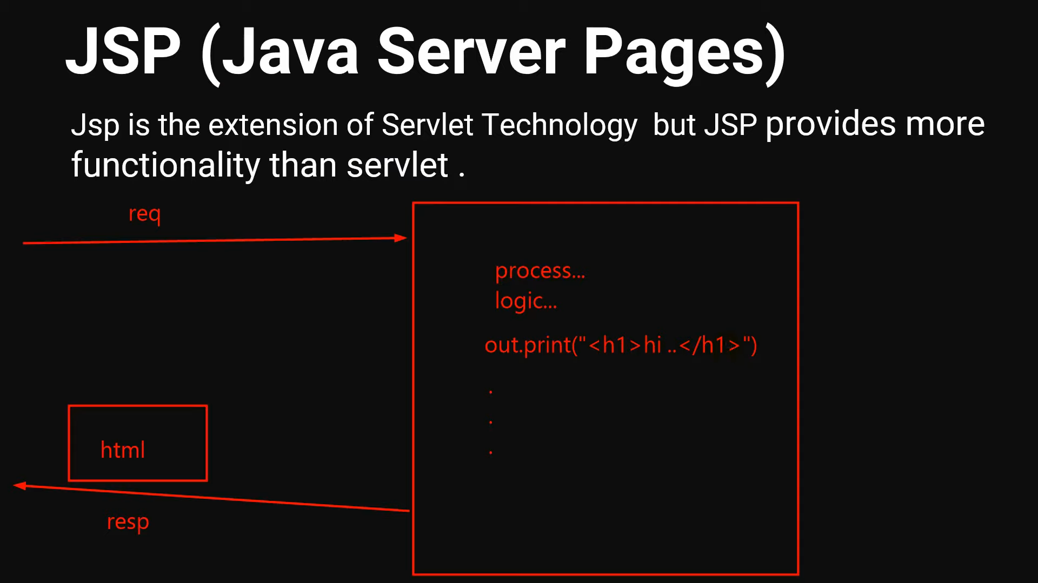


Slide 9
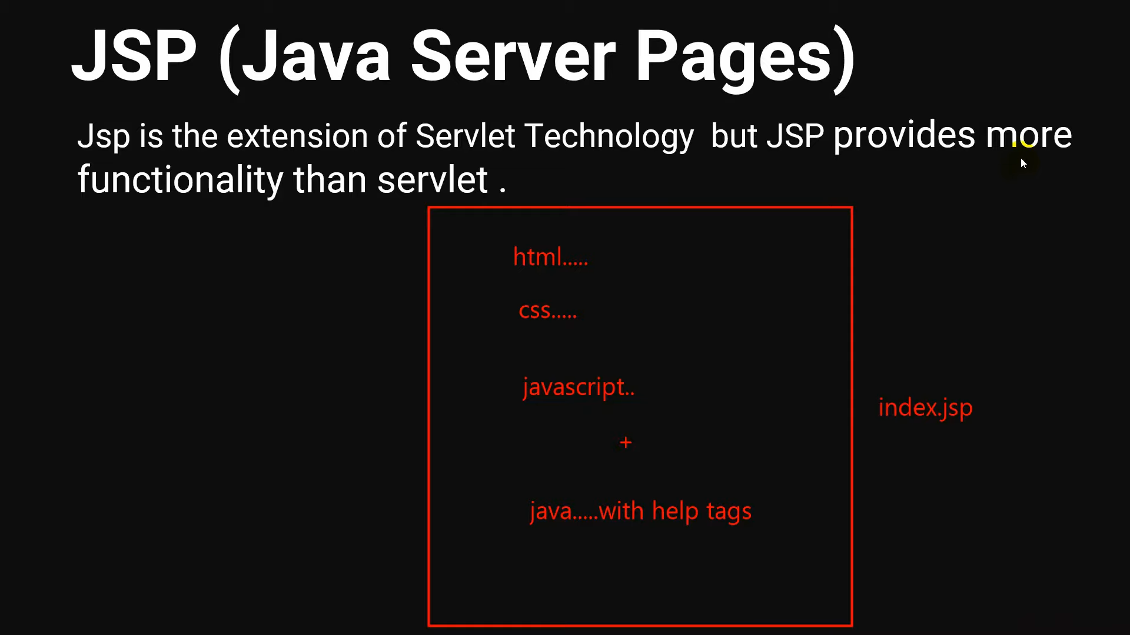



Slide 11
Getting started

Slide 12
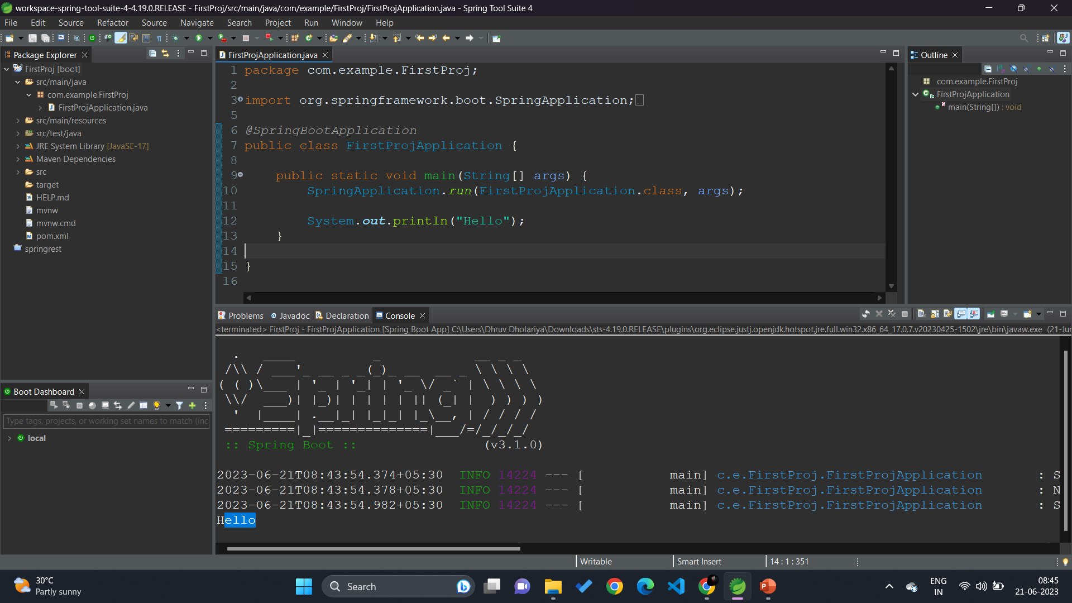

Slide 13
Dependency injection and @autowired

Slide 14
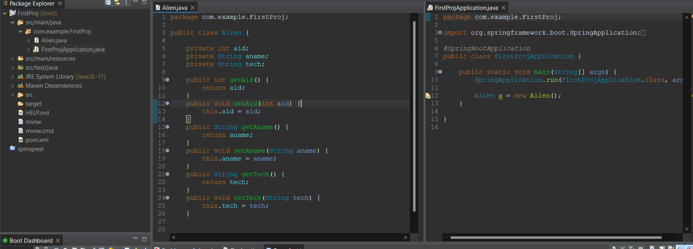
Here we are manually creating a object
But spring says , hey . No need to create object , I will give you . You just focus on logic .

Slide 15
But how to get that object ? ➔

Slide 16
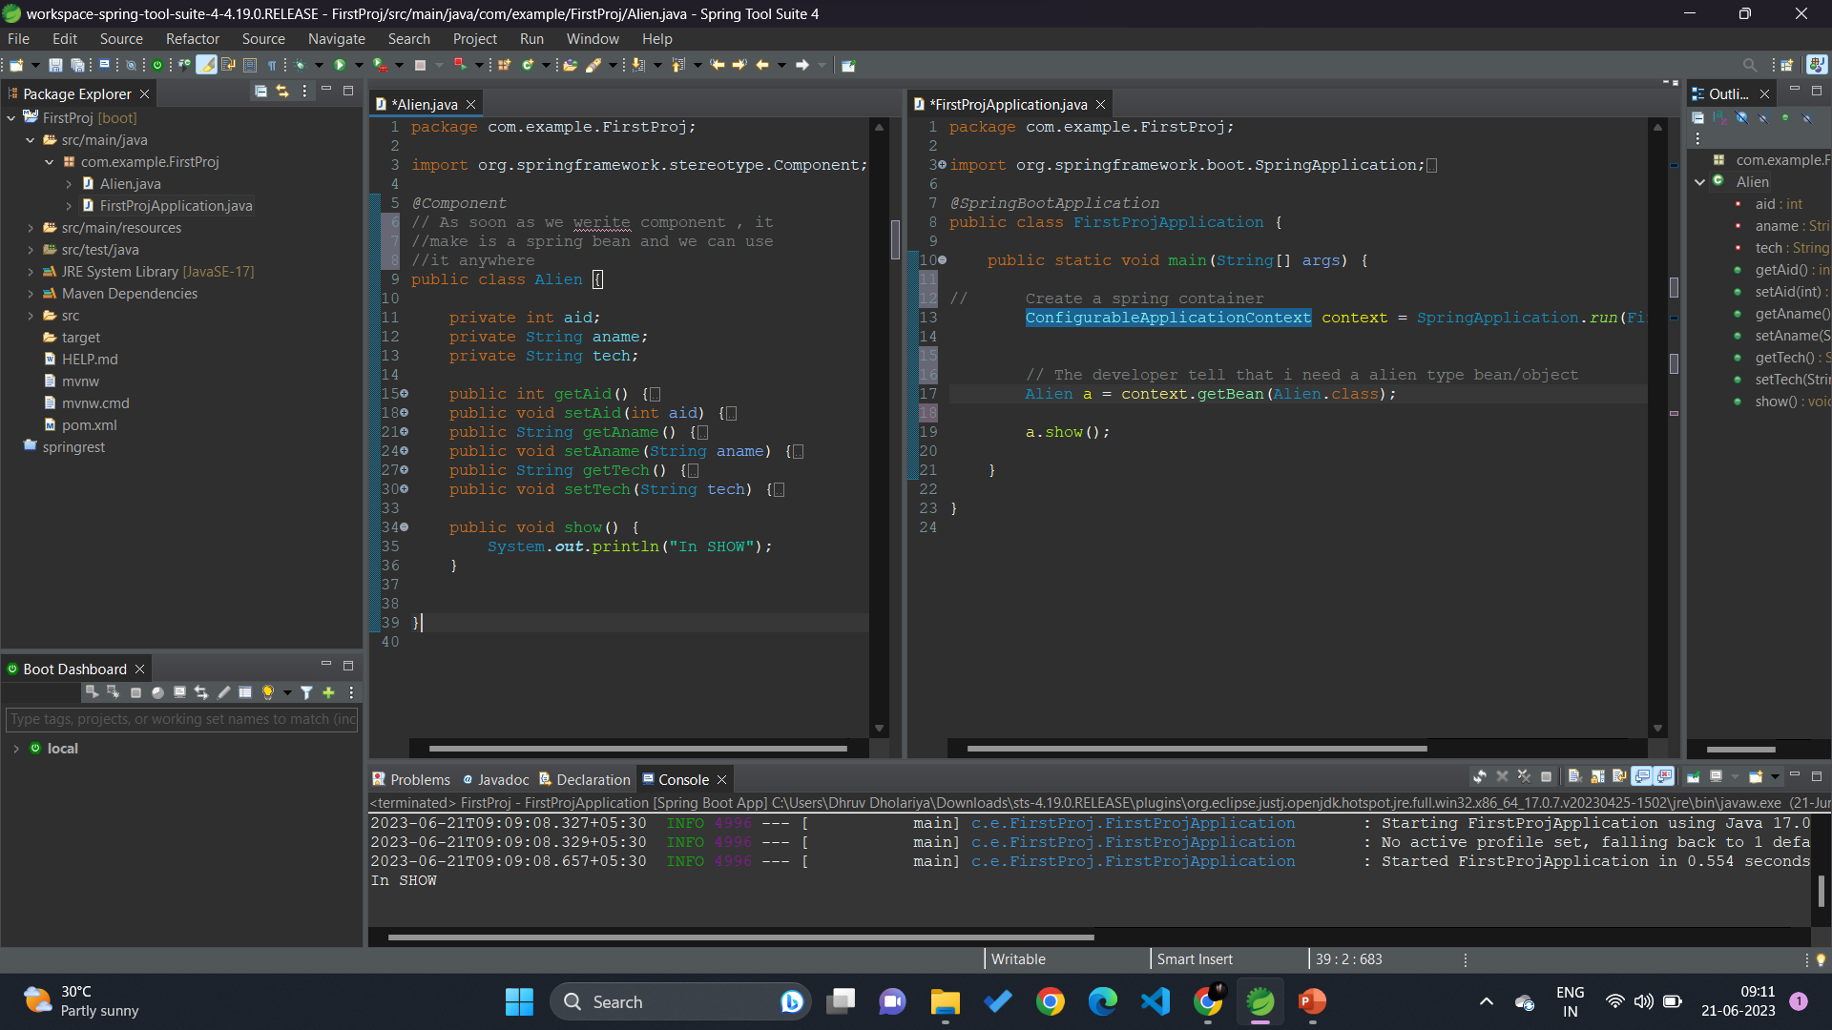

Slide 17
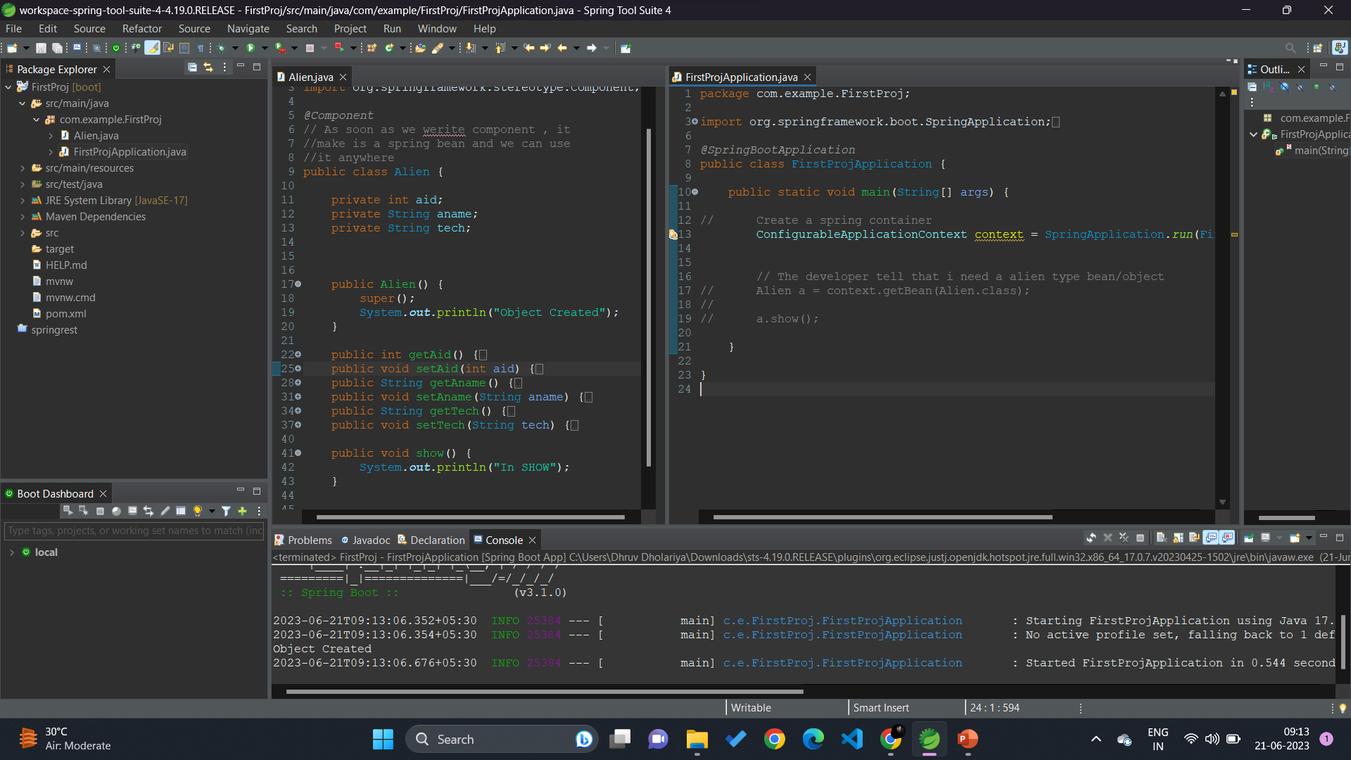

Even if you don’t ask , spring boot give you a object by default .

Slide 18
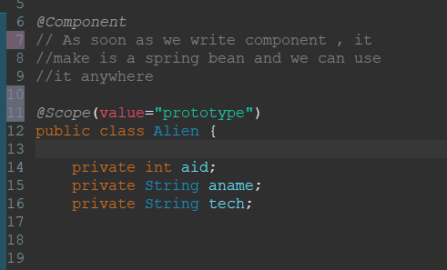


Spring use feature of singleton design pattern . ➔ In singleton we get only one instance .
So even if you declare a1 and a2 , still in console we will get “Object created ”only once .
Change from singleton to prototype.
Now we can create multiple objects

Slide 19
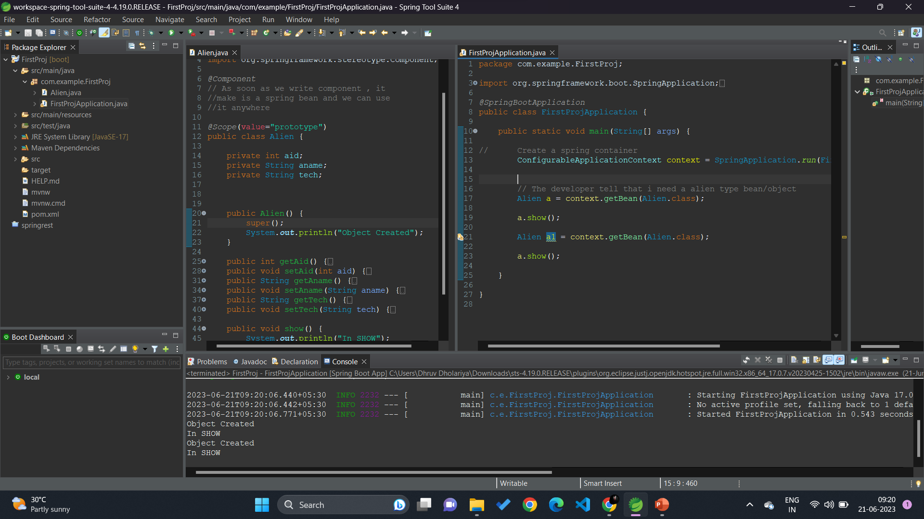



Slide 20













Spring container
alien ->default name
laptop ->default name
Laptop class
Alien class
The problem is A1 is dependent on L1 . How do A1 know about L1 . ➔
@Autowired – It will tri to search object in spring container

Slide 21
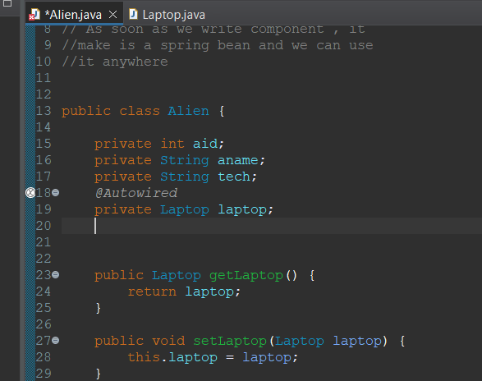
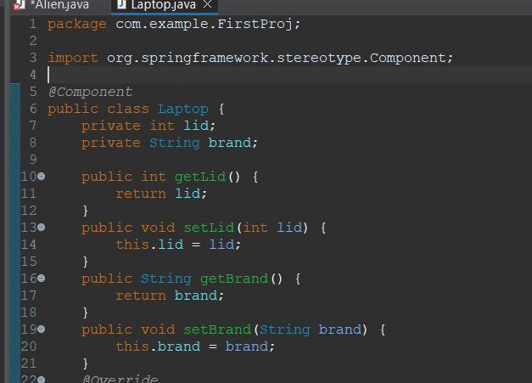

Slide 22
WEB APPLICATION USING SPRING BOOT

Slide 23
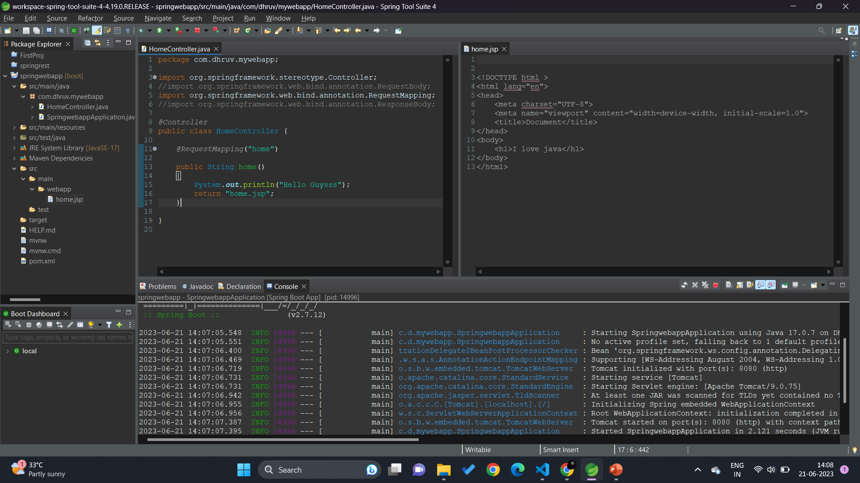


No need of any external server as we have tomcat

Slide 24
APPLICATION PROPERTIES FILES

Slide 25
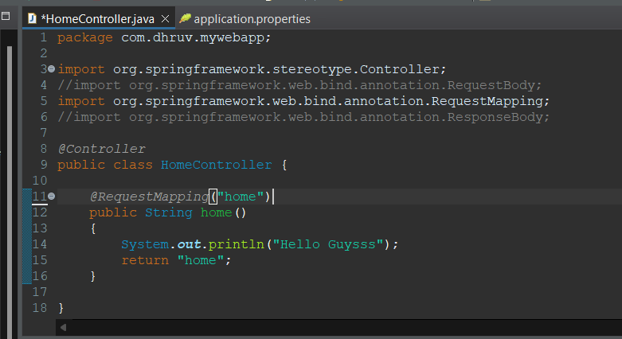
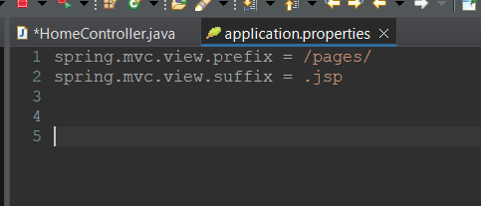
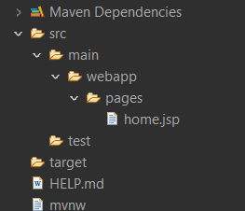

Slide 26
Accepting client data

Slide 27
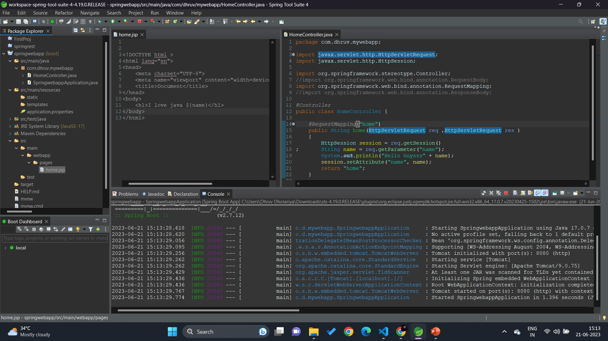
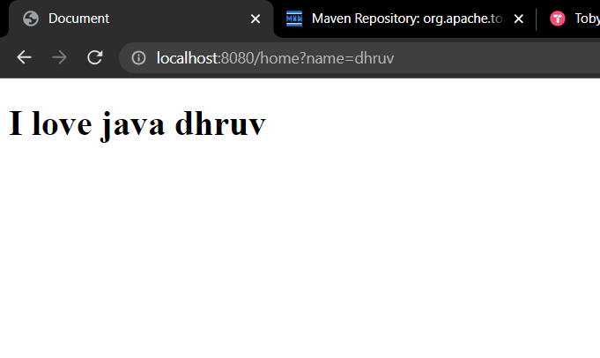

Slide 28
We can make this all stusff more easy ➔

Slide 29
ModalandView

Slide 30
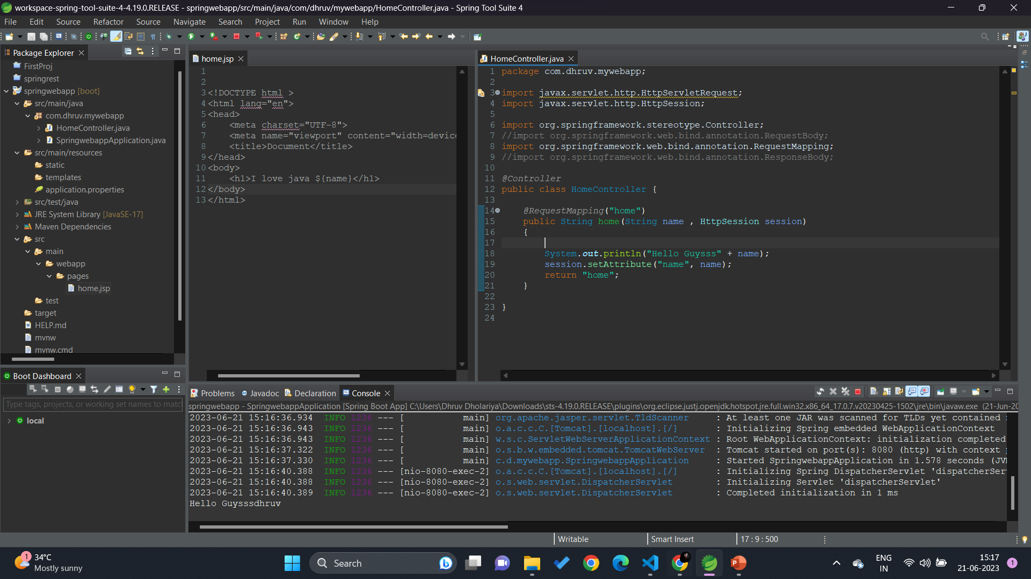


Slide 31
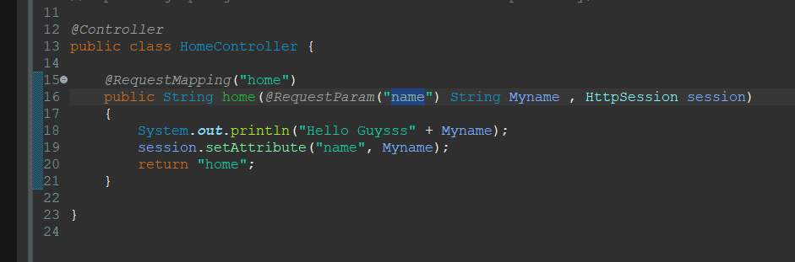

Slide 32
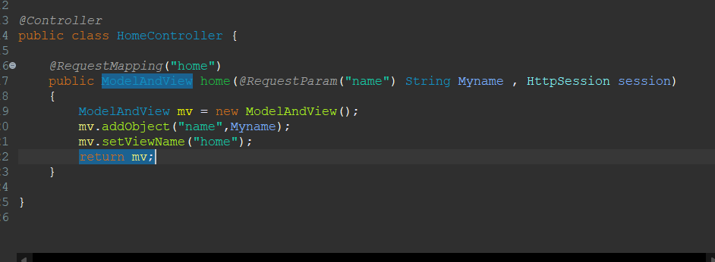
Why we need session ?
We need session because , we are adding data in session object and that data is going to home.jsp

Slide 33
SPRING BOOT MODEL OBJECT

Slide 34
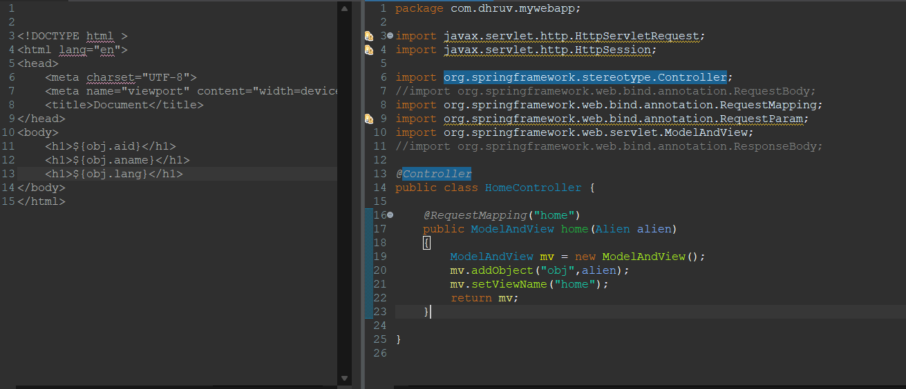
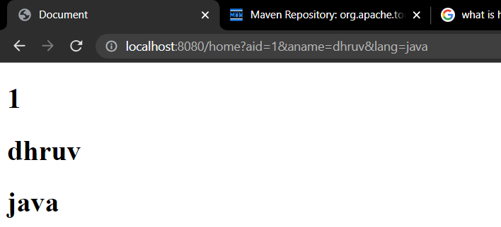

Slide 35
JPA | MVC | H2 Example

